Slide 1
Onboard, Maintain, Destroy
The Secure Application Lifecycle

Slide 2
Attention
MMS sessions are 60-75 minutes followed by LONG Q&A
Please hold detailed questions until that Q&A starts
Feel free to ask clarification questions
Remind the speakers to use Zoom It when you can’t see

Slide 3
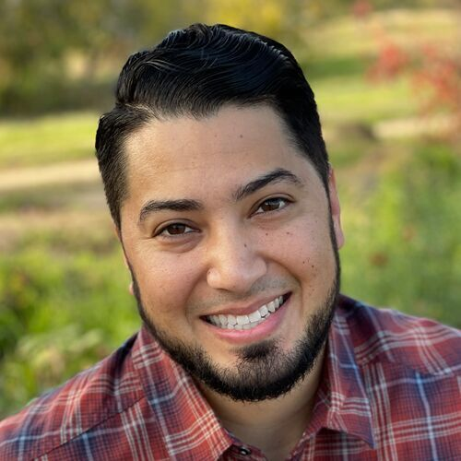
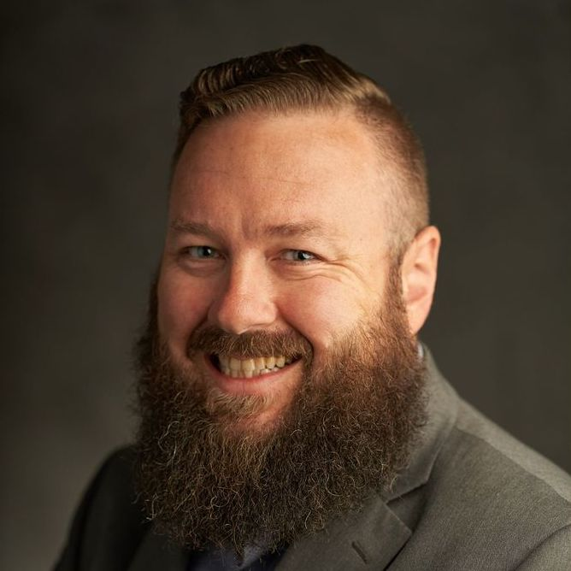




Michael Escamilla
Jim O’Neil
Customer Engineer, PMPC
Customer Engineer, PMPC
fishingpreacher
in/Michael-a-escamilla
jim.oneil@patchmypc.com
in/jimtheengineer

Slide 4
The First Section
With a little description here

Slide 5
Navigating Third-Party App Onboarding: Our Agenda
This presentation will guide us through a strategic framework for managing third-party applications from initial request to retirement. We will move beyond just the technical installation and focus on a collaborative, risk-aware approach.

Slide 6
Key Discussion Points:
The Onboarding Challenge: Why a streamlined process is critical for security and efficiency.
Our Four-Pillar Approval Framework: A look at the key teams involved—Architecture, Security, Procurement, and Legal—and their roles in the decision-making process.
Technical Deep Dive: Specific considerations for different software types, including the unique risks of AI and LLMs.
Beyond the Install: What happens after a tool is approved, including lifecycle management and continuous monitoring.
Tools and Automation: How we can use technology to make our process more efficient.

Slide 7
Welcome – “Launch the Boat”
Applications are the backbone of enterprise operations, yet onboarding third-party solutions introduces significant risks; security breaches, compliance failures, and operational inefficiencies.
While other sessions this week cover installation, deployment, and updates, we’ll focus on a critical first step: establishing robust onboarding processes. Who approves applications for use in enterprise environments? Who ensures compliance with licensing terms and verifies code security for your endpoints?
In this session, we won’t offer a one-size-fits-all solution but will empower you to build a tailored framework that strengthens security and compliance in your organization.

Slide 8
How to win at life
According to Brian

Slide 9
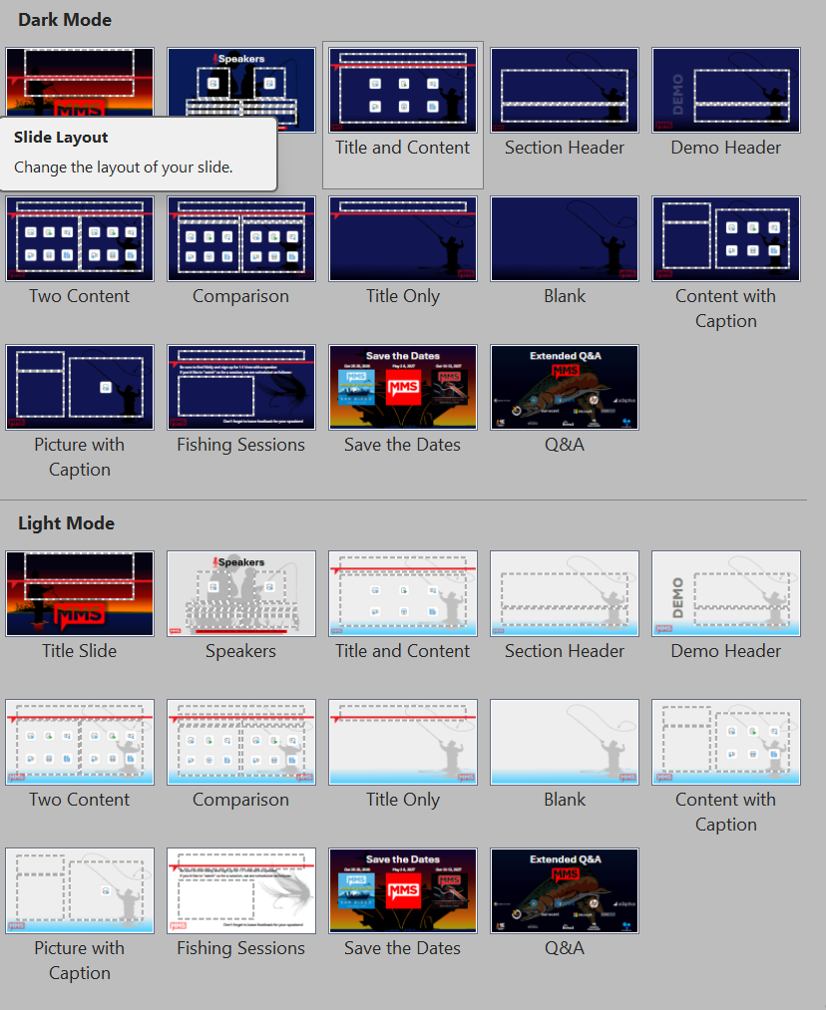
Don't Cross The Streams!
New for this year: LIGHT MODE
Use one or the other; NOT BOTH.
Session Title, Save the Dates, and Q&A are the same regardless of mode.

